Slide 1
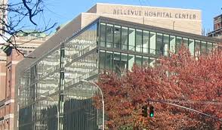
Pain, Peril and Resilience
The Crossroads Generation:
Hawthorne Smith, Ph.D.
Director; Bellevue Program for Survivors of Torture
President; National Consortium of Torture Treatment Programs
June 27, 2022
Notes:
Thanks to the International Center for Multigenerational Legacies of Torture.
Thanks to Drs. Mary Fabri and Yael Danieli

Slide 2
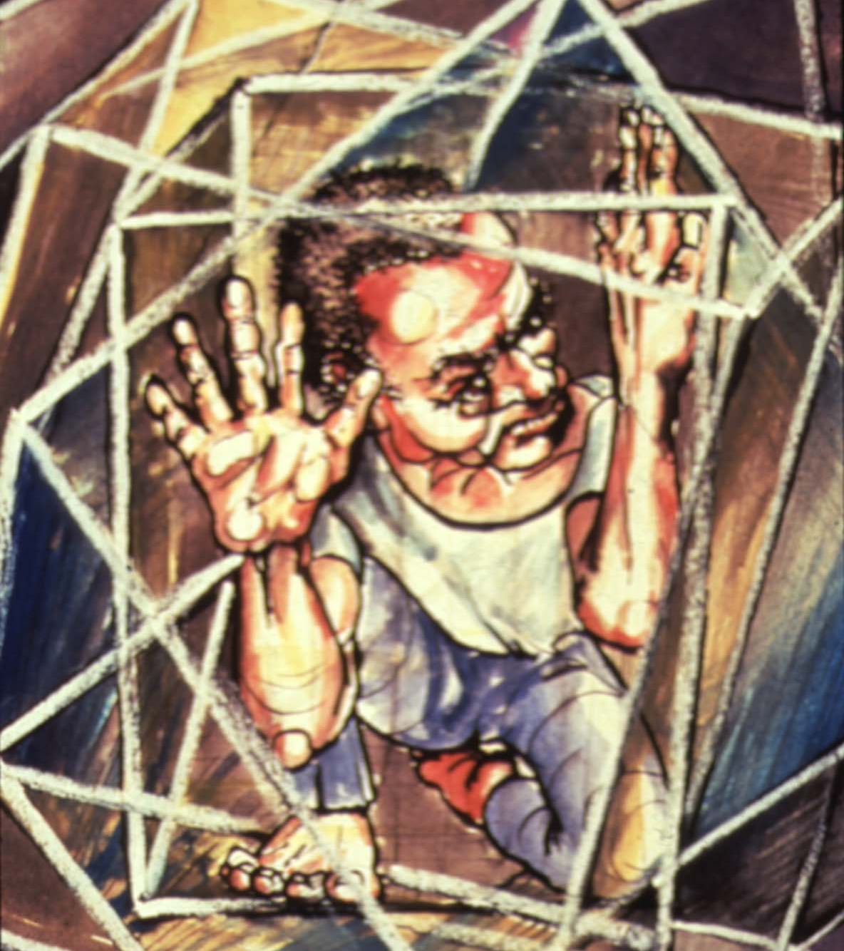
Acknowledgement … Juneteenth
IRCT
Hawthorne Smith, Ph.D.
Bellevue PSOT
Notes:
The need to pay homage, respects
The unnamed heroes in my prayers
Witness to another crossroads generation

Slide 3
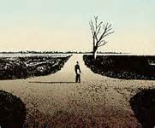
Crossroads Generation
Trauma
Recurrent Stressors
Uncertainty
Possibilities for the future
Hawthorne Smith, Ph.D.
Bellevue PSOT
Notes:
Crossroads as a place of magic. Profane and divine
Sacrifice. Patience. Fear
Painful irony - trying to do what’s best for the family by sacrificing your participation and role.
Ongoing bad news from home. Survivor guilt.

Slide 4
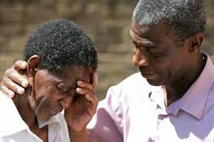
The Unseen Family Separation Crisis
FIFO – LIFO
“The second torture”
“Am I a good father?”
“The family in front of you…”
Hawthorne Smith, Ph.D.
Bellevue PSOT
Notes:
Increased severity of sx’s;
Destruction of family units
Self - deportations

Slide 5
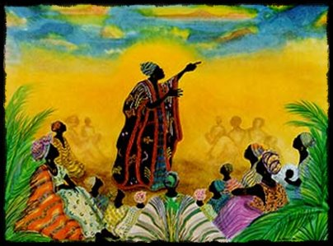
“Subversive Healing”
Do not give the victory to the undeserving.
“L’esprit de partage”
It does not have to be therapy to be therapeutic
Character v. Circumstance
Needed – not just needy
“Rien n’est facile, mais tout est possible”
Hawthorne Smith, Ph.D.
Bellevue PSOT
Notes:
Survivors – not victims
Shared humanity. “Sorrow shared is halved; Joy shared is doubled”
Francophone African - “La Famille”
Empowerment. Normalization

Slide 6
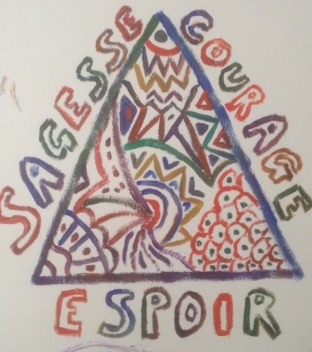
“How do we change the world?...”
Wisdom, Courage, Hope
Hawthorne Smith, Ph.D.
Bellevue PSOT
Notes:
Wisdom Courage Hope - The active capacity to hope as a healing endeavor

