Slide 1
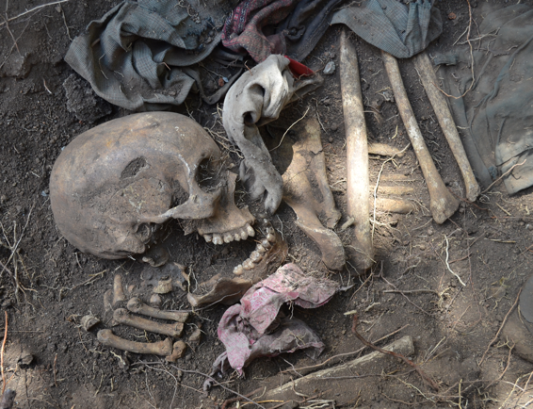
MULTIGENERATIONAL LEGACIES OF TORTURE
Shari Eppel – Forensic Anthropologist and Psychologist
ZIMBABWE
27 June 2022

Slide 2
There are slides that show skeletal human remains….
Please note – full permissions to show human skeletal remains have been given by all concerned relatives throughout this presentation….families tell us that they want others to see the truth their bones can tell.
If seeing bones is going to be upsetting, perhaps do not join this presentation, although remains are always shown with dignity and respect, in order to illustrate a forensic or humanitarian reality.

Slide 3
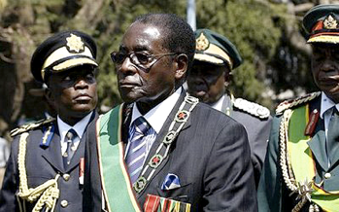
ZIMBABWE
1890s – 1979 – White rule
British Colonial rule was brutal and so was the War of Liberation 1963 – 1979
April 1980: Independence
First Prime Minister, Robert Gabriel Mugabe takes power.

Slide 4
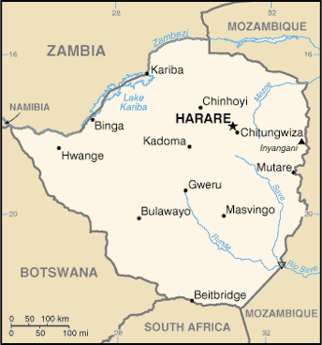
Gukurahundi: 1983-85
Massacres 1983
Massacres 1984

Slide 5
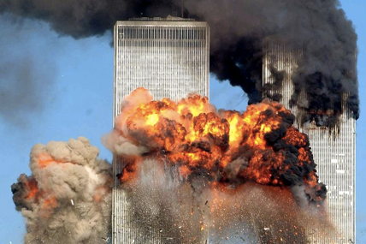
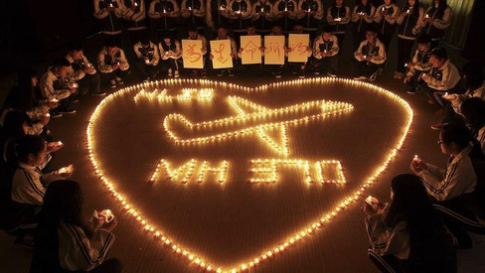
Ambiguous loss:
The person is psychologically still there but physically missing: a universal experience
“To know that somebody is alive you have to see them. To know that somebody is dead, you have to see the body. That is all I ask of you.”
[appeal from relative of missing passenger on Malaysian Flight 370, disappeared 8 March 2014]
Notes:
Universality of experience – 41% of 9/11 dead still not identified by DNA, still attempts to do so – because families need it. Malaysia – some relatives still texting their missing, think they are on a desert island. Others think aliens took the plane – there is no certainty, no closure.

Slide 6
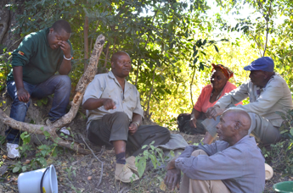
Zimbabwe: ancestors play a central role
The angry spirits of the unburied, dishonored dead are the most serious legacy of the massacres –
causing droughts, disease, failed marriages, infertility and failed development projects….
How can families “forget” to honour their dead and be at peace themselves?
Bones in the Forest
“Culturally it is not right for someone’s bones to be exposed. It brings bad luck which denies people rain.” [2014 interview]
“Human bones are in the bush and some are exposed – I don’t think God is happy with that.” [2014 interview]
Notes:
Not PTSD, but angry spirits. Cannot be solved with empathy, have to return the bones.

Slide 7
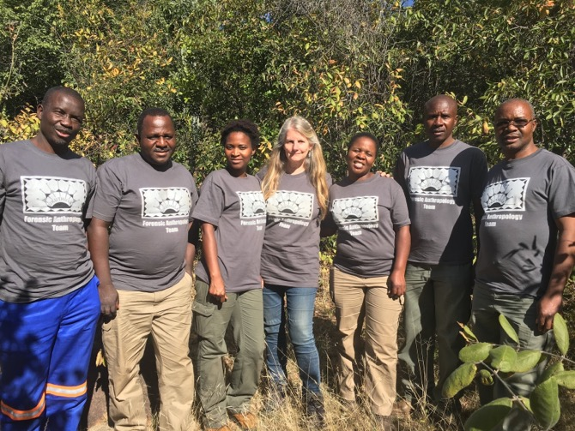
Ukuthula Forensic Anthropology Team (UFAT)
Notes:
----- Meeting Notes (5/9/14 15:43) -----
font change

Slide 8
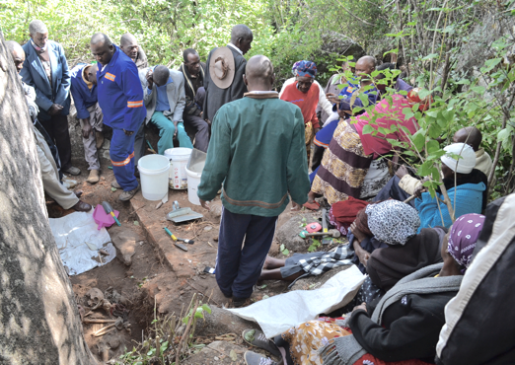
Forensics can help to fulfil the humanitarian objective of the “right to know” what happened to family members
Which is linked to the “right to truth” [UNCHR, 2005]

Slide 9
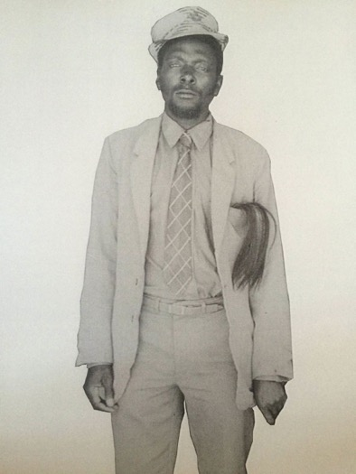
Yesterday, when one of his daughters saw the photos for the first time, she said that she had never seen her father before – although she used to dream about her father a lot, he had no face in her dreams….
“Daniel was a brave man.”

Slide 10
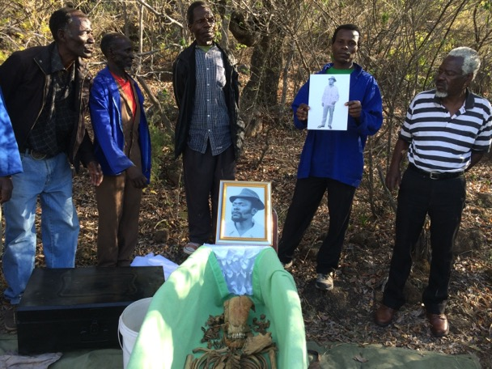
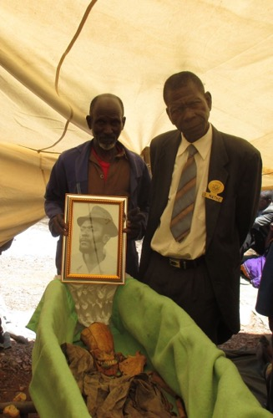
Daniel – with his family
- and with the Chief
Notes:
----- Meeting Notes (5/9/14 15:43) -----
font change

Slide 11
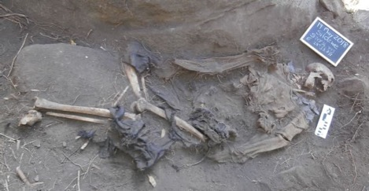
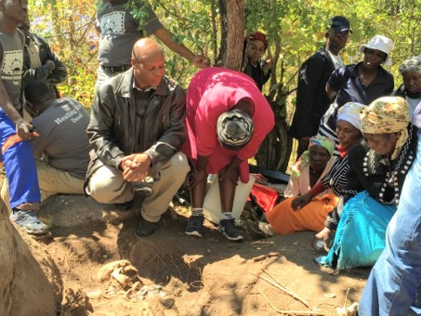
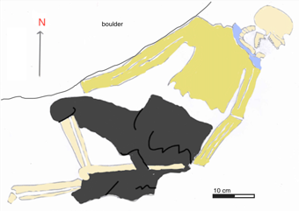
Exhumation of Julius, 2018
Prayers for Julius
Hand drawn map

Slide 12
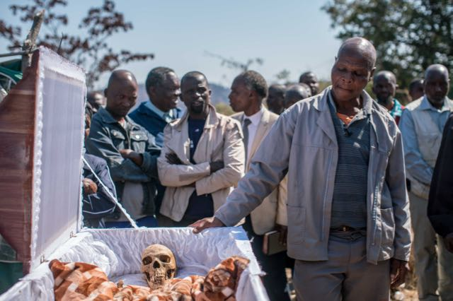
Reburial, 2018
Notes:
----- Meeting Notes (5/9/14 15:43) -----
font change

Slide 13
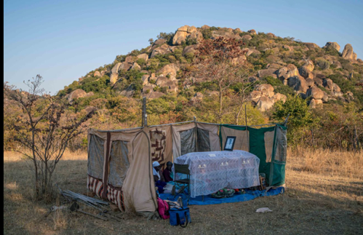
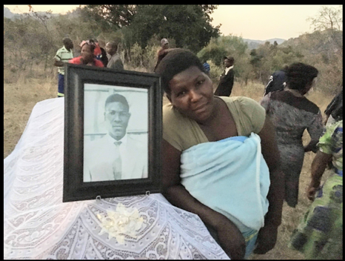
Reburial of Julius Mvulo Nyathi

Slide 14
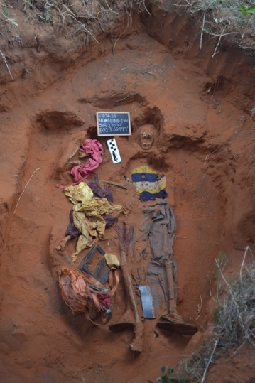
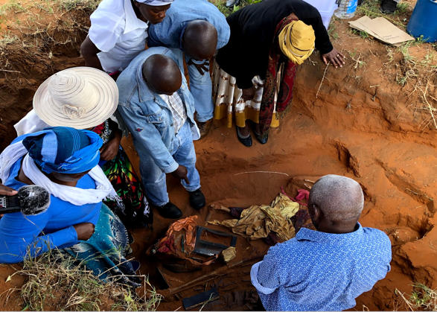
Relatives remembering, in the site

Slide 15
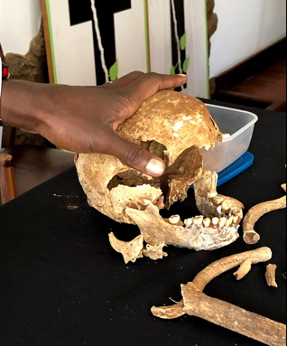
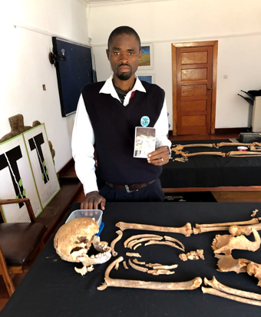
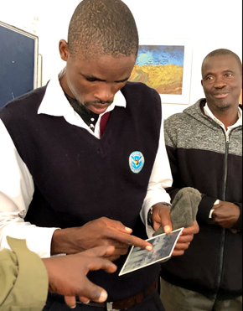
Recovery of memory – Xolani meets his father for first time

Slide 16
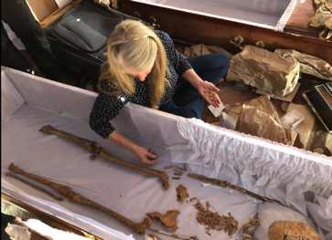
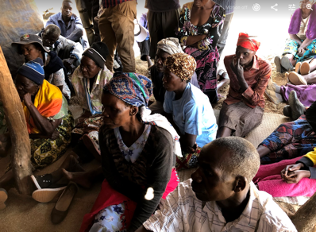
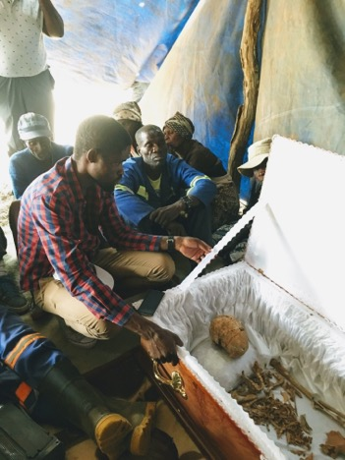
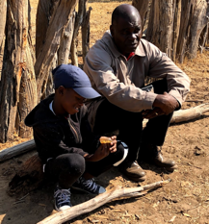
Justin and Thembi come home – Aug 2019

Slide 17
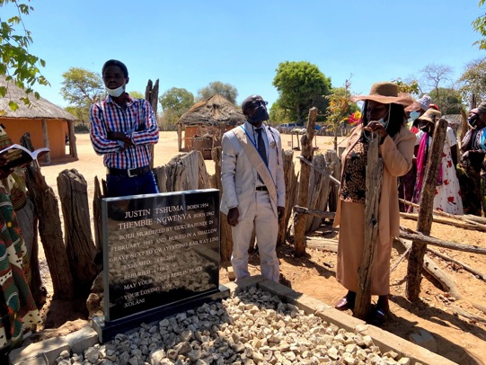
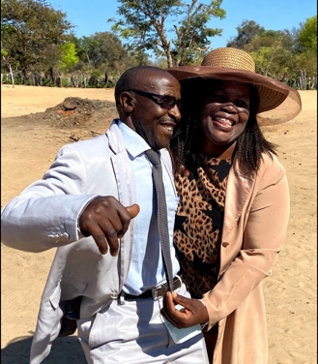
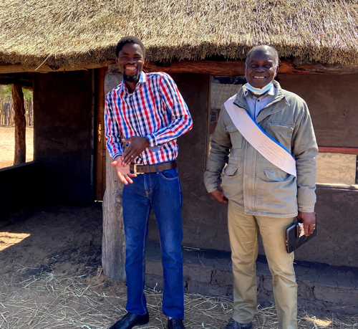
Tombstone unveiling: Sept 2021

