Slide 1
Long-term Impact of Torture on Families:
Multigenerational Legacies of Torture
Mary Fabri, PsyD
Advisory Council Member
International Center for the Study, Prevention, and Treatment
of Multigenerational Legacies of Trauma (ICMGLT)

Slide 2
Multigenerational Trauma
Also referred to as trans-generational trauma or intergenerational trauma
Trauma passed down from those who directly experienced the events – a single individual, multiple family members, or a collective trauma that impacted a larger cultural, ethnic, racial, religious, or other community groups.

Slide 3
Context
Torture is a deeply disturbing and distressing event of inflicting intentional pain and suffering
Single episode
Persistent, ongoing with multiple experiences of torture and exposure to traumatic events
Torture may directly impact one individual and indirectly impact the entire family and/or community

Slide 4
Psychological Consequences of Torture
Include, but not limited to:
Depression, anxiety, difficulty regulating emotions, low self-esteem, disturbed sleep and appetite, mistrust, suicidal ideation, substance abuse, and interpersonal violence.
Torture changes a person.

Slide 5
A torture survivor may isolate physically and/or withdraw emotionally resulting in others:
Feeling abandoned
Feeling unloved
Experiencing a lack of warmth or intimacy
Feeling fear and/or anger toward survivor
Feeling insecure
Self-blame

Slide 6
A survivor full of fear & worry can lead to
Overprotectiveness
Suspiciousness
Inappropriate aggressiveness
Need to control
Family members become fearful and worried

Slide 7
Avoidance can lead to:
Imposed silence about the past
Intolerance of conflict
Atmosphere of fear of upsetting the survivor (“walking on eggshells”)
Feelings of shame and guilt
Developing own explanation of “why”

Slide 8
Sleep problems
Disrupts the every family member’s sleep patterns
Negative outlook on life
Impacts every family member and their feelings about each other, their community, and beyond

Slide 9
Drug and alcohol abuse
Alters relationships with family members
Models unhealthy coping strategy
Lead to absence from home

Slide 10
Family’s Responses
Feeling responsible for the survivor’s feelings and behaviors
Feeling unable to be a good child or spouse and parent
Resentment
Irritability
Misunderstandings
Acting out behaviors

Slide 11
Family of Torture Survivors
May develop:
Depressive symptoms
PTSD symptoms
Somatisation
Behavioral problems
And thus, a pattern may evolve across generations, the legacies of the trauma of torture.

Slide 12
Implication for Treatment
The heterogeneity of responses of families of survivors to their Holocaust and post-Holocaust life experiences… emphasizes the need to guard against expecting all victim-survivors to behave in a uniform fashion and to match appropriate therapeutic interventions to particular forms of reaction.
Danileii, Y. (1985) In C. R. Figley (Ed.), Trauma and its wake (pp. 295-313). New York: Brunner/Mazel

Slide 13
Implication for Treatment
Individual and family responses
Culture
Worldviews
Religious beliefs
Support systems

Slide 14
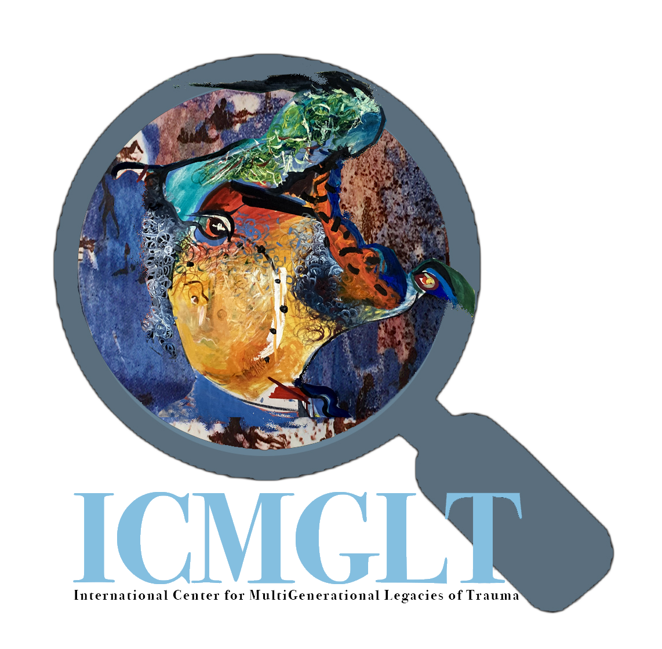
Resources
https://icmglt.org/
Extensive resource library
Danileli Inventory of Multigenerational Legacies of Trauma
Thank you for listening
and caring.

